Slide 1
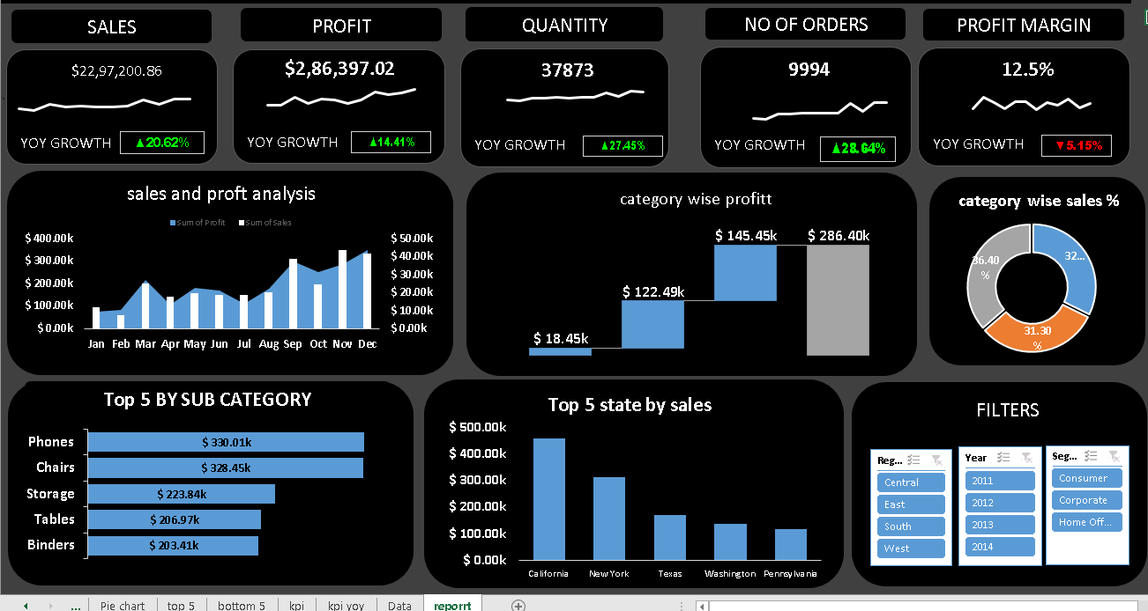
E-Commerce Sales Dashboard

